Slide 1


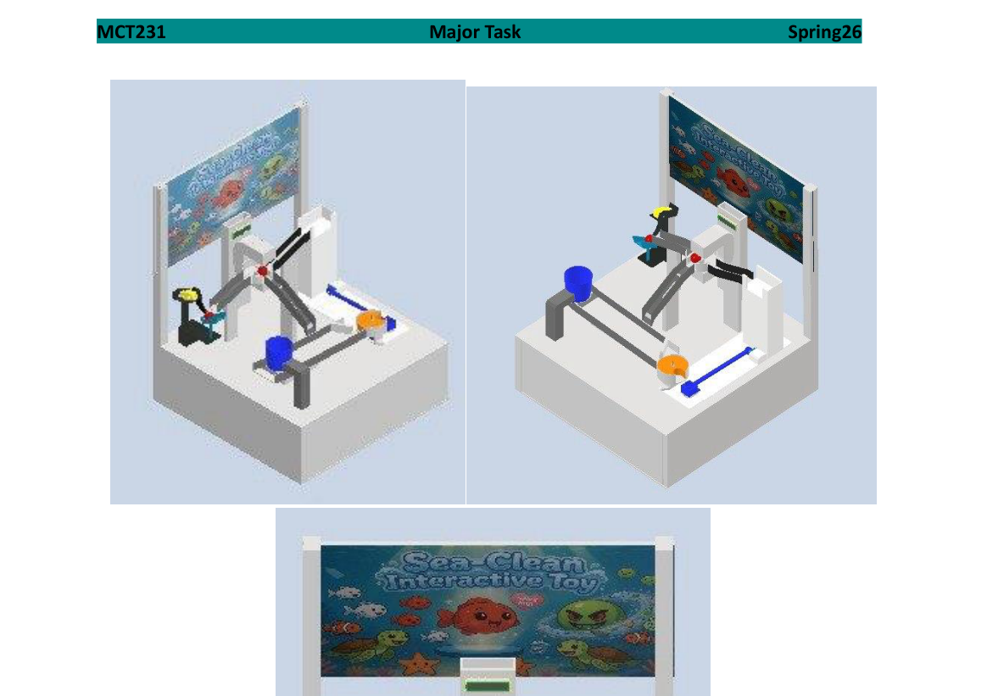
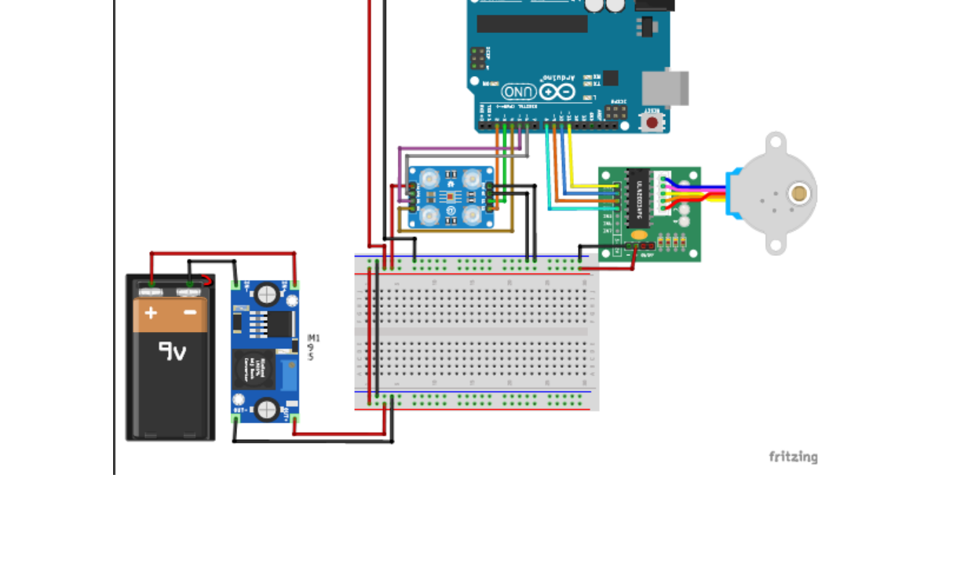
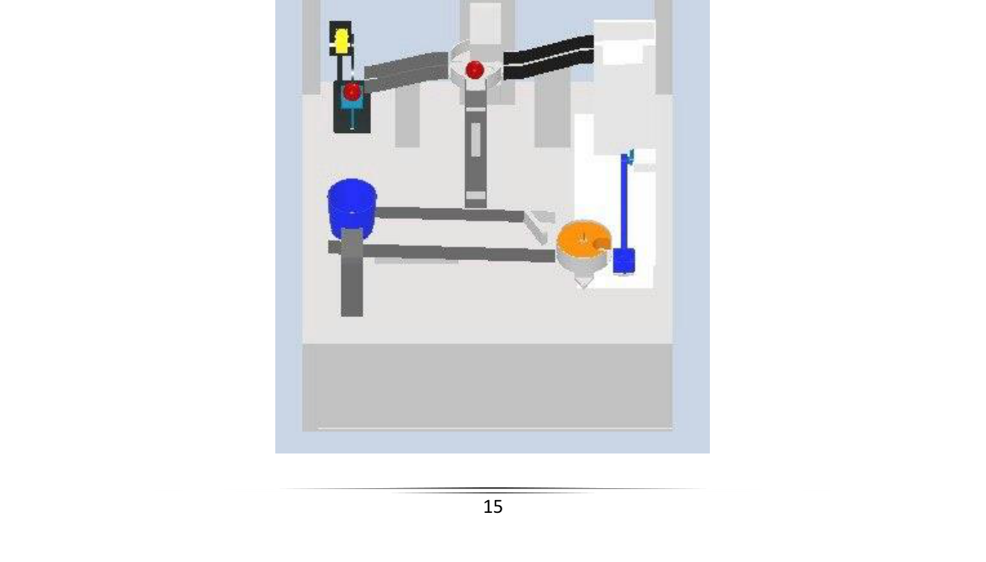
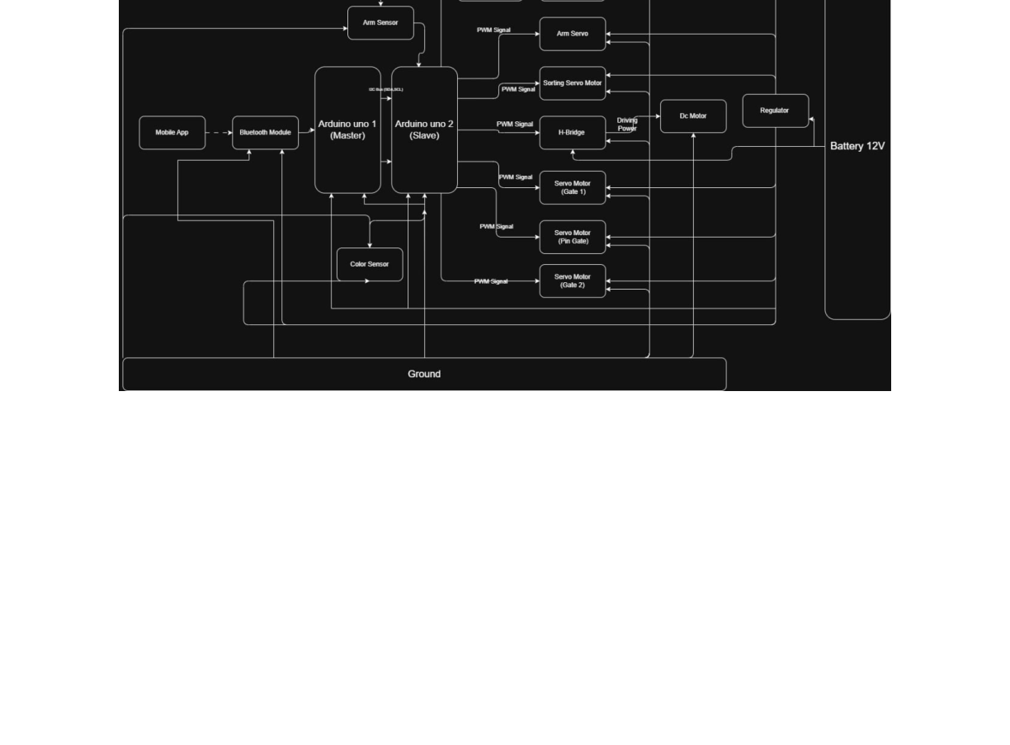
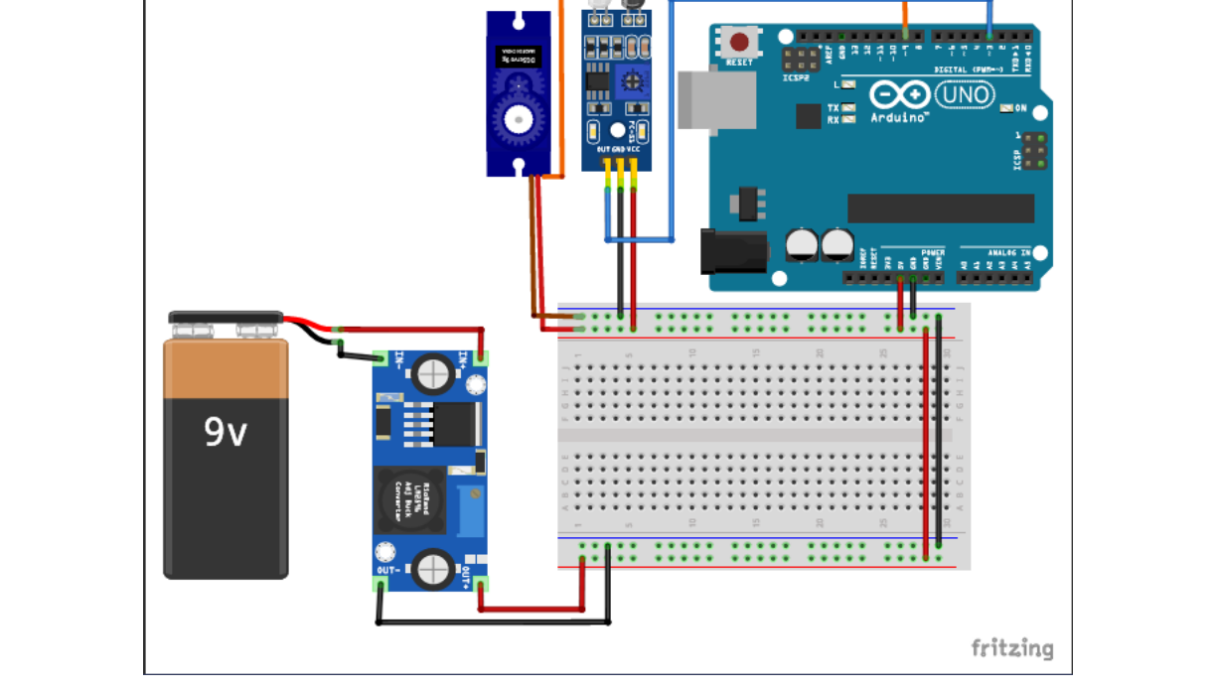
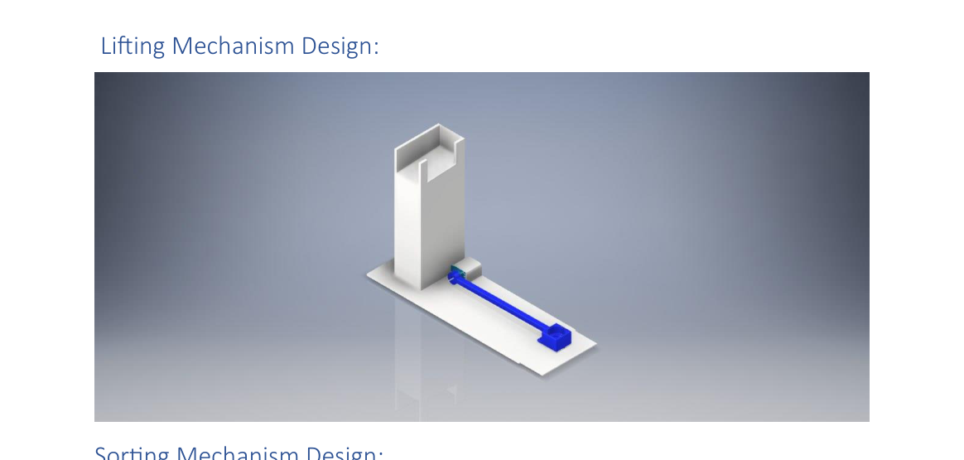

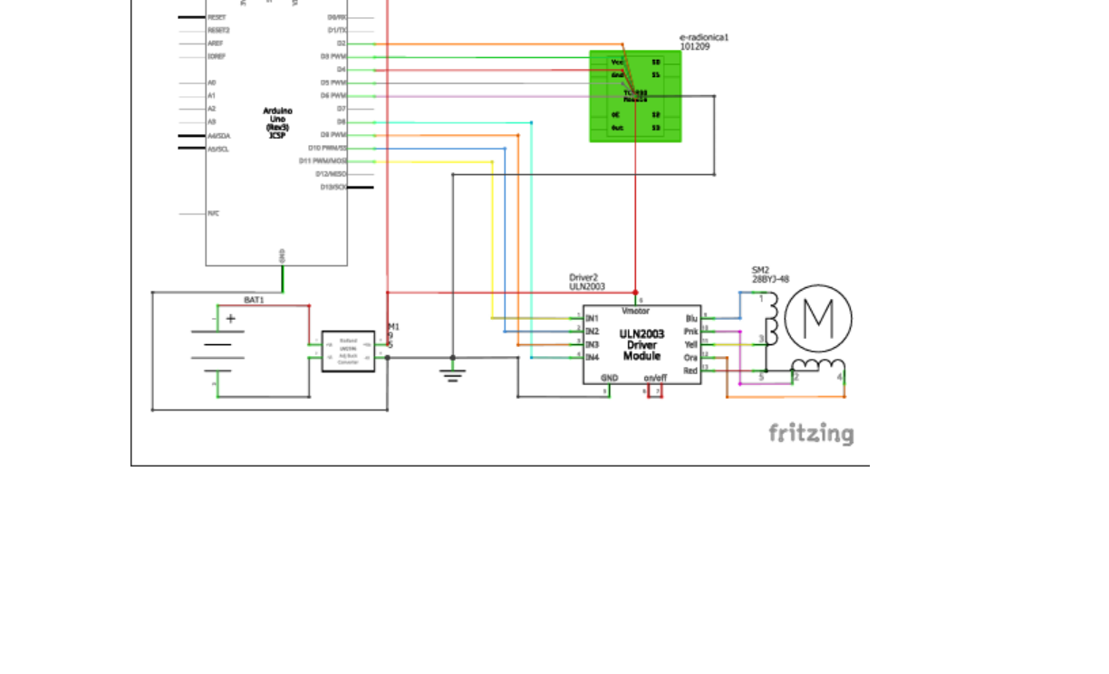
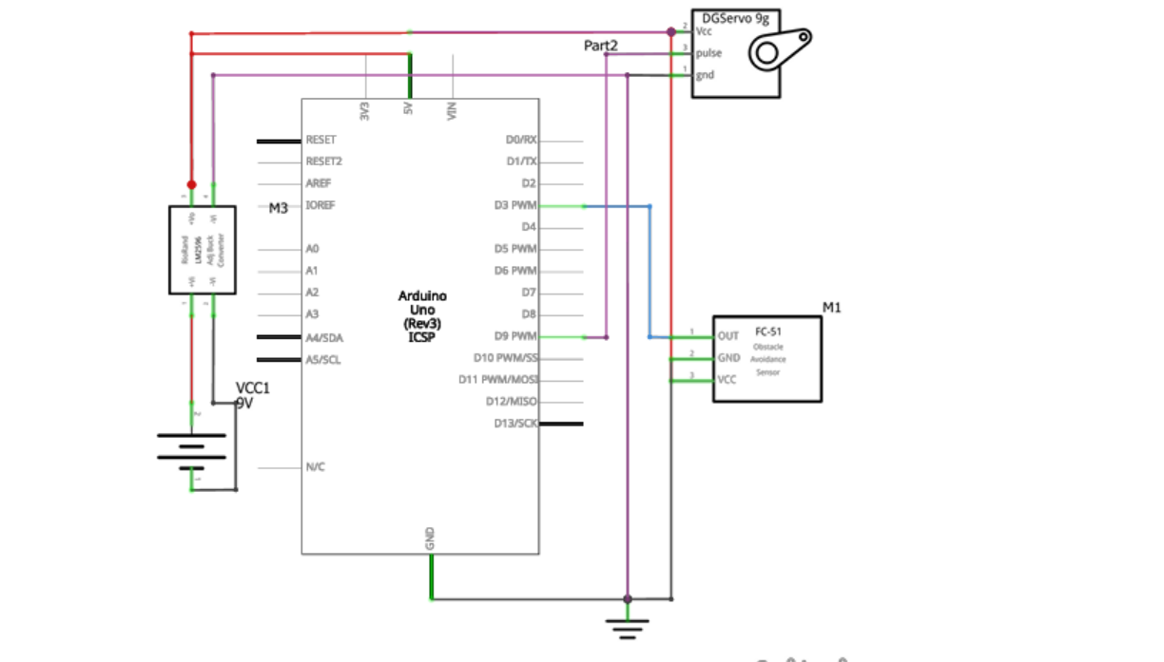
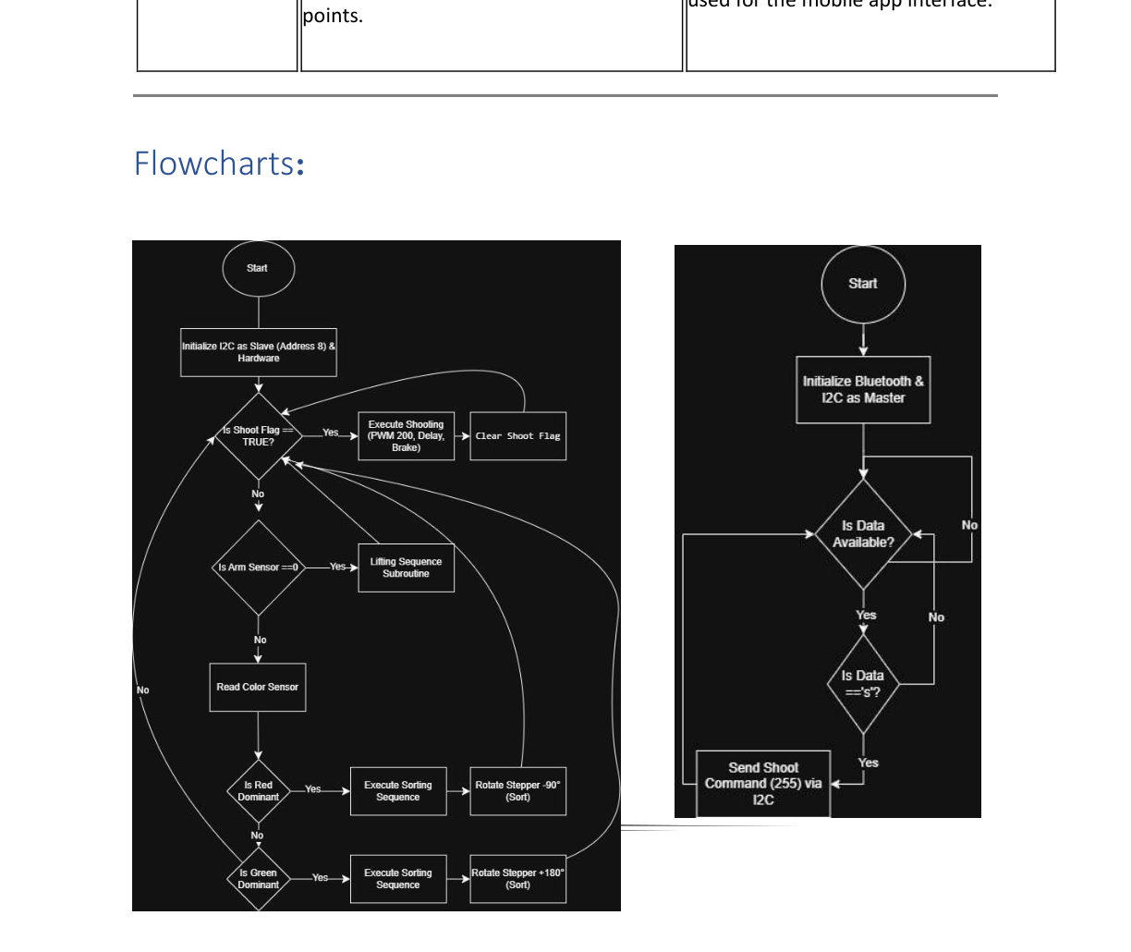

Sea-Clean Interactive Toy
MCT231 Final Presentation | Spring 2026 | Ain Shams University – ICHEP
Youssef Khattab · Ayman Atef · Youssef Makhlouf · Omar Abdelsamea · Eslam Hosam
Faculty of Engineering | Ain Shams University | ICHEP
🌊 Project Overview
🖥️ CAD Renders — Full Assembly
⚡ Wiring Diagrams
The Spiro Monitoring System is a mechatronic educational system that simulates marine conservation for children aged 2–10, teaching environmental responsibility through three automated mechanisms in a closed-loop system.
Sorting Subsystem — Fritzing Wiring Diagram
60×60
3
2–10
cm Footprint
Mechanisms
Age (yrs)
Ball enters via single entry point — green=fish, red=garbage
IR sensor triggers servo arm to lift ball 90° to sorting track
Touch LCD prompts child to identify ball type via servo gate
DC motor shooter launches garbage into collection bin via Bluetooth
Trapdoor servo resets bin and returns balls — closing the loop
Fig. 1 — Isometric views of full integrated assembly (Autodesk Inventor)
Arduino Uno · TCS3200 Color Sensor · ULN2003 Driver · 28BYJ-48 Stepper · 9V Supply
⚙️ System Architecture
Lifting Subsystem — Fritzing Wiring Diagram
Fig. 2 — Top view showing ball pathway and mechanism layout
🔧 Subsystem CAD Renders
Lifting Mechanism
Sorting Mechanism
Arduino Uno · FC-51 IR Sensor · LM596 Buck Converter · DGServo 9g · 9V Supply
🔌 PCB Schematics (Proteus)
Sorting PCB
Lifting PCB
📊 Control Flowcharts
FS90MG Servo · 90° · 1 s
28BYJ-48 Stepper · color sensor
Shooting Mechanism
📈 Key Results & Validation
🔩 Actuator Sizing Summary
TT DC Gear Motor · 180° · 0.5 s · v₀=1.78 m/s · Range=28 cm
Lifting Mechanism
Mechanism | Motor Selected | τ Required | τ Rated
Lifting Arm | FS90MG Servo | 4.14 N·cm | 17.65 N·cm
Sorting Gate | 28BYJ-48 Stepper | 0.20 N·cm | 2.94 N·cm
Shooter | TT DC Gear Motor | 1.11 N·cm | 7.85 N·cm
Trapdoor | SG90 Micro Servo | 0.41 N·cm | 17.65 N·cm
📋 Product Design Specification (PDS)
FS90MG servo: 4.3× safety margin (17.65 vs 4.14 N·cm required)
Parallel axis: I_pivot = 17.86 kg·cm² — 90° in 1.0 s via PWM
IR sensor (FC-51) reliably detects ball at entry point
Specification | Value / Requirement
Dimensions (L×W×H) | 60 × 60 × 80 cm (max 100×100×100 cm)
Materials | 3D Printed PLA+ (20% infill) + Laser-cut Wood
Microcontrollers | Dual Arduino Uno — I²C communication protocol
Power Source | Single 9V Battery + LM596 Buck Converter
Sensors | FC-51 IR Obstacle + TCS3200 Color Sensor
User Interface | Touch LCD/TFT + Processing.io Bluetooth App
Safety | Filleted edges, hidden wiring, child-safe forces
Custom PCB | Min. 1 PCB per subsystem — Proteus designed
Ball Coding | Green = Fish (return) · Red = Garbage (shoot)
Sorting Mechanism
28BYJ-48 stepper: 14.7× margin (2.94 vs 0.20 N·cm required)
TCS3200 distinguishes red/green in real time — routes accordingly
Gate rotates −90° (garbage) or +180° (fish) per detection
Shooting Mechanism
TT DC Gear Motor: 7× margin (7.85 vs 1.11 N·cm required)
180° sweep in 0.5 s — α = 25.13 rad/s² angular acceleration
Projectile safe: v₀ = 1.78 m/s, H_max = 4 cm, T = 0.18 s
📸 Prototype Photos
Electrical System
Dual Arduino Uno: Master handles Bluetooth, Slave handles actuation
I²C protocol: Master sends shoot command (byte 255) to Slave
Custom PCBs fabricated for sorting and lifting subsystems
📐 Projectile Analysis
[ Prototype Photos ]
Parameter | Symbol / Formula | Value
Launch Angle | θ | 30°
Target Range | R | 0.28 m
Initial Velocity | v₀ = √(Rg / sin 2θ) | 1.78 m/s
Time of Flight | T = 2v₀ sinθ / g | 0.18 s
Max Height | H = (v₀ sinθ)² / 2g | 0.040 m
✅ Conclusions
To be added after physical build
Fully closed-loop mechatronic toy integrating 3 mechanisms under dual-Arduino I²C control — all operating within a single unified pathway
All actuators sized from first principles via Autodesk Inventor iProperties — every motor exceeds requirements by a minimum 3× safety factor
Color-based sorting via TCS3200 enables real-time autonomous ball discrimination, routing fish back and directing garbage to the shooter
Projectile trajectory mathematically validated: v₀=1.78 m/s launches garbage 28 cm at θ=30°, staying within child-safe impact limits
Custom Proteus-designed PCBs fabricated for both subsystems ensuring clean, modular, and maintainable electrical architecture
Marine-themed educational design with touch LCD + Bluetooth app delivers engaging, age-appropriate interaction for children aged 2–10
Modular plug-and-play assembly and accessible wiring enable easy subsystem repair, replacement, and future enhancements
👥 Team & Acknowledgements
Team Members Mohamed Farag (2421025) Yousef Ashraf (2421036) Zeyad Omar (2421042) Course: MCT231 — Mechatronics | Spring 2026 Institution: Ain Shams University, Faculty of Engineering (ICHEP)
University of East London (UEL)
🔗 Project Resources & Links
QR
QR
QR
GitHub Repository
Demo Video
Documentation
Code & Firmware
System Operation
Report & BOM
MCT231 Final Presentation — Spring 2026 | Sea-Clean Interactive Toy | Ain Shams University – ICHEP | © 2026

